Slide 1
The Theory of Income
Determination

Slide 2






The circular flow of income
INJECTIONS
Firm
Export
expenditure (X)
Investment (I)
Government
expenditure (G)
Consumption of
domestically
produced goods
and services (C_{d})
Factor
payments
BANKS, etc
GOV.
ABROAD
Import
expenditure (M)
Net
taxes (T)
Net
saving (S)
Household
WITHDRAWALS

Slide 3
THE KEYNESIAN REVOLUTION
Keynes’ rejection of classical theory
  rigidities in the labour market
  the problem of deficiency of demand
  rejection of increased saving as a means of increasing investment
  rejection of a balanced budget
Keynes’ analysis of employment and inflation
  the importance of aggregate demand
  the multiplier process

Slide 4
Assumptions
A single concept of national income (Yd)
A constant level of potential/full employment national income (Y_{f})
Existence of unemployment
Constant price level

Slide 5
The Consumption Function

Slide 6
Absolute Income Hypothesis
Y_{d} = C + S
C = a + b Y_{d}
  C = current consumption
  a = autonomous consumption
  b = marginal propensity to consume
  Yd = Current disposable income (Y-tax + transfers)

Slide 7
Absolute Income Hypothesis
Keynes relied on the psychological law that the satisfaction of “immediate primary needs” is a stronger motive for consumption than “accumulation.”
  For example, if a millionaire and a welfare recipient each received $500, the millionaire would likely just add the money to her savings account since her primary needs are already met.
The welfare recipient, on the other hand, would likely immediately spend the money on food, clothing, and shelter.

Slide 8

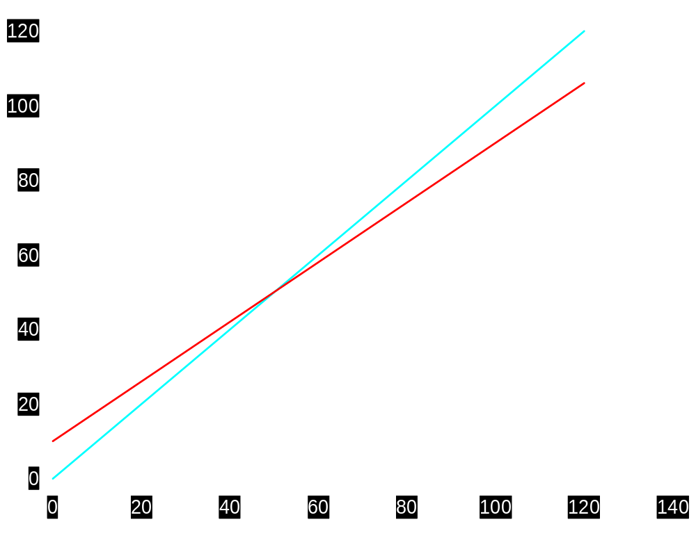

The consumption function
Y
C
ΔC = 8
ΔY = 10
Consumption (£bn)
mpc = ΔC / ΔY
= 8/10
= 0.8
50
50
Y (£bn)

Slide 9
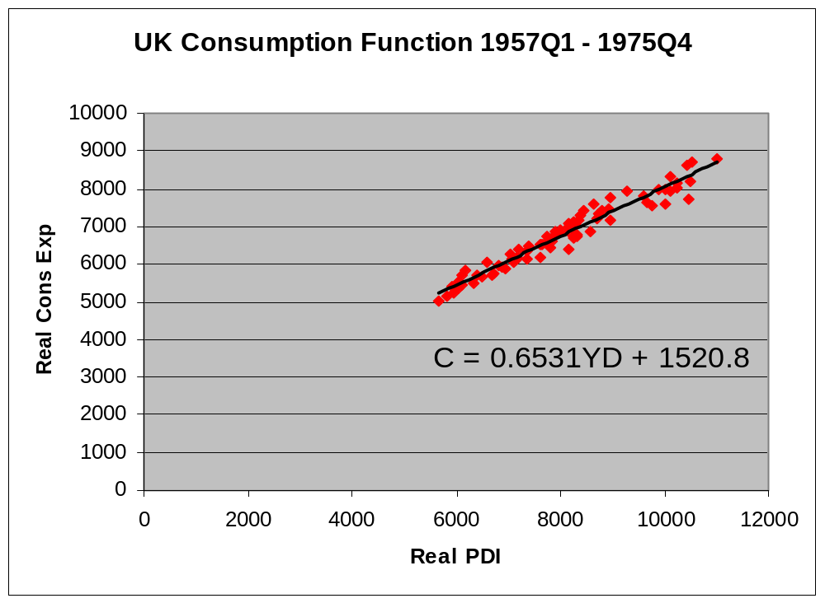
UK Consumption Function (SR)
4
Notes:
4

Slide 10
Autonomous consumption
  A change in autonomous consumption is unrelated to income and causes a shift in AE
    Wealth
    Credit
    Expectations
    Age
    Price Levels
      ↓PL → ↑real wealth (savings)
      ↓PL → ↑NX

Slide 11
Properties
Value of MPC is constant
0<MPC<1
APC = a/yd + b

Slide 12
Savings Function
  S = Y_{d} – C
= Y_{d} – a-b Y_{d}
S = -a + (1 - b) Y_{d}
Thus MPS = 1-b
APS = -a/yd + (1-b)
MPC + MPS =1
APC + APS = 1

Slide 13
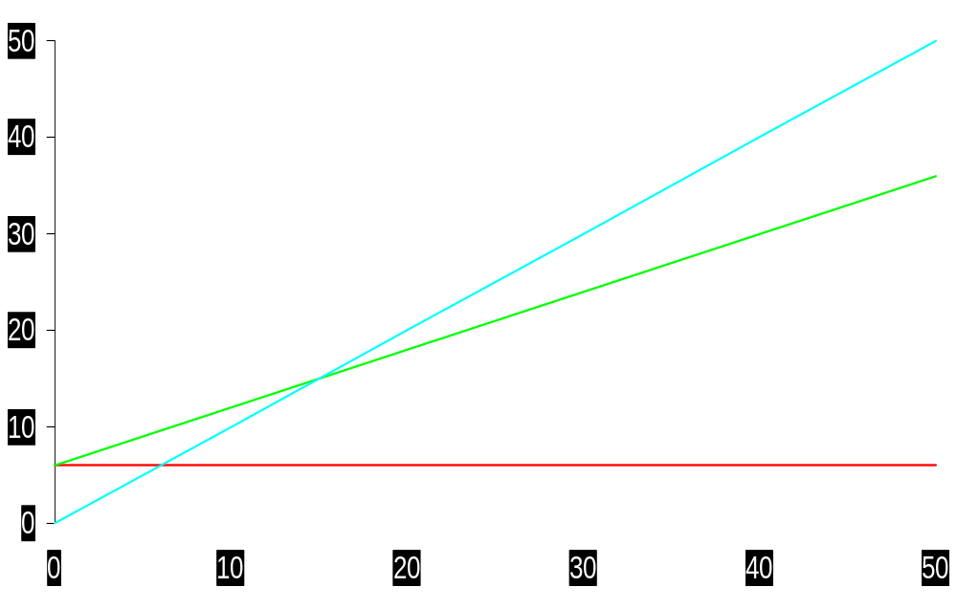
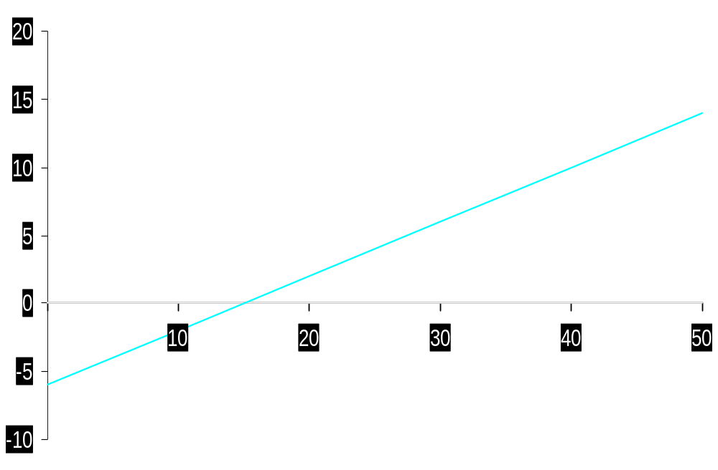
Yd = C
Consumption ($1000)
C_{total}
C_{autonomous}
dY ($1000s)
savings function
Dissaving
Savings ($1000)
Saving
Yd ($1000s)
C – Yd = 0

Slide 14
Implications
As an economy prospers, income goes up and so does the savings rate (APS).
Thus, prosperity leads to stagnation
Reasons
As Y goes up, APC goes down and APS goes up. Thus, consumption expenditure falls leading to fall in AD.
Savings do not lead to investment as the opportunities for investment may not be favorable.
This leads to increase in inventory, fall in production and then to stagnation (Secular Stagnation Hypothesis)

Slide 15
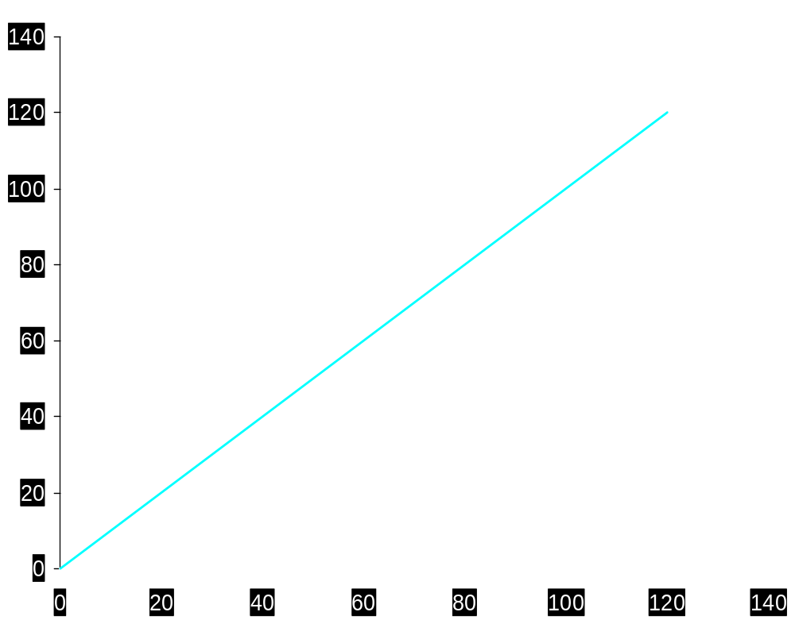

Shifts in the Consumption function
C=Yd
C₃
C₂
Consumption (£bn)
C₁
Y (£bn)

Slide 16
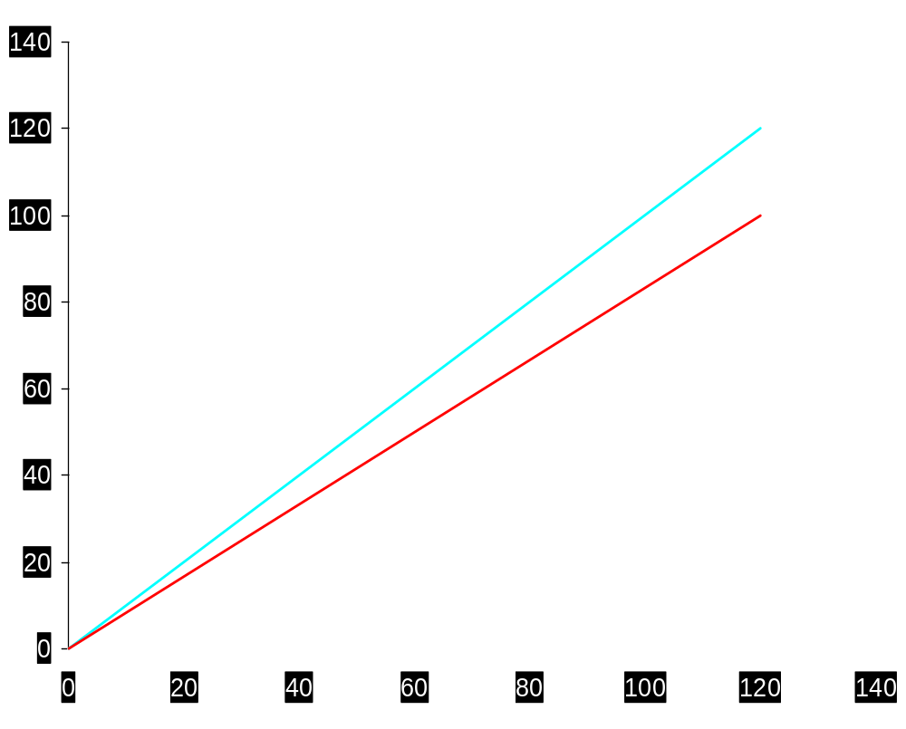
Long-run and short-run consumption functions
Y
C_{long run}
C_{10 years’ time}
C_{5 years’ time}
Consumption (£bn)
C_{now}
Y (£bn)

Slide 17
Early Empirical Successes:
Results from Early Studies
Households with higher incomes:
  ⇒ MPC > 0
  ⇒ MPC < 1
  ⇒ APC ↓ as Y ↑
Very strong correlation between income and consumption
  ⇒ income seemed to be the main
  determinant of consumption

Slide 18
Objections
  Found valid in cross-section data only.
Kuznets found a constant APS using time-series data.
Great depression has not occurred again.

Slide 19
The Consumption Puzzle
Consumption function from long time series data (constant APC )
C
Consumption function from cross-sectional household data
(falling APC )
Y

Slide 20
Alterative Models
Irving Fisher and Inter-temporal Choice
Life Cycle Income Theory
Permanent Income Hypothesis
Relative Income Hypothesis

Slide 21
Life Cycle Income Theory: Modigliani, Ando and Brumberg
Consumption depends on a person’s life-time income and not on the current income.

Slide 22
Irving Fisher and Intertemporal Choice
The basis for much subsequent work on consumption.
Assumes consumer is forward-looking and chooses consumption for the present and future to maximize lifetime satisfaction.
Consumer’s choices are subject to an inter-temporal budget constraint,
a measure of the total resources available for present and future consumption

Slide 23
The basic two-period model
Period 1: the present
Period 2: the future
Notation
  Y₁ is income in period 1
  Y₂ is income in period 2
  C₁ is consumption in period 1
  C₂ is consumption in period 2

Slide 24
Deriving the intertemporal budget constraint
  In the first period:
  S = Y₁ − C₁
  (S < 0 if the consumer borrows in period 1)
(S>0, if the consumer consumes less than income)

Slide 25
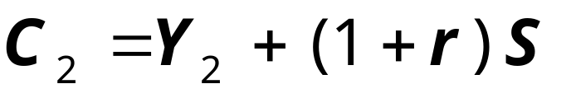
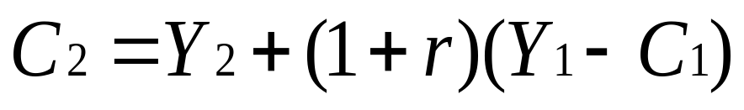
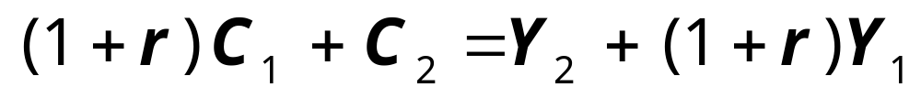
Deriving the intertemporal budget constraint
Period 2 budget constraint:
Here consumption equals the accumulated savings including the interest earned + income in period II.
To derive the consumer's budget constraint, combine the above two equation and solve it for C2.
Rearrange to put C terms on one side
and Y terms on the other:
Finally, divide through by (1+r ):
Notes:
Explain the intuition/interpretation of the period 2 budget constraint.
If students understand it, then everything else follows nicely.

Slide 26
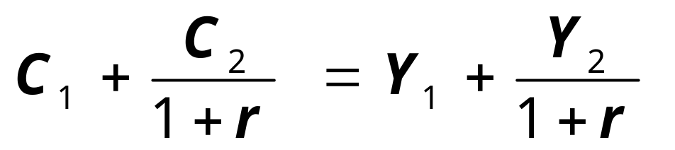
The intertemporal budget constraint
present value of
______________
present value of
____________
slide <number>

Slide 27
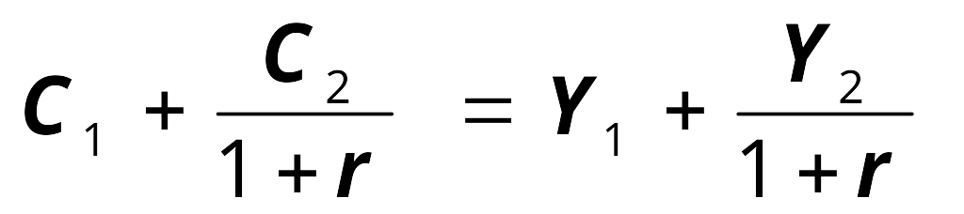
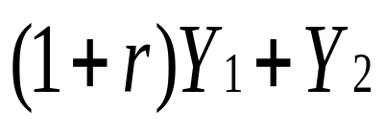
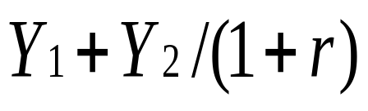
The intertemporal budget constraint
C₂
The budget constraint shows all combinations
of C₁ and C₂ that just exhaust the consumer’s resources.
Consumption = income in both periods
C1=Y1
C2 =Y2
_____
Y₂
_______
C₁
Y₁
Notes:
The point (Y1, Y2) is always on the budget line because C1=Y1, C2=Y2
is always possible, regardless of the real interest rate or the existence of borrowing constraints.
To obtain the expression for the horizontal intercept, set C2=0 in the equation for the intertemporal budget constraint and solve for C1. Similarly, the expression for the vertical intercept is the value of C2 when C1=0. There is intuition for these expressions. Take the vertical intercept, for example. If the consumer sets C1=0, then he will be saving all of his first-period income. In the second period, he gets to consume this saving plus interest earned, (1+r)Y1, as well as his second-period income.
If the consumer chooses C1<Y1, then the consumer will be saving, so his C2 will exceed his Y2.
Conversely, if consumer chooses C1>Y1, then consumer is borrowing, so his second-period consumption will fall short of his second-period income (he must use some of the second-period income to repay the loan).

Slide 28
The intertemporal budget constraint
C₂
The slope of the budget line equals
1
(1+r )
Y₂
C₁
Y₁
Notes:
The slope of the budget line equals -(1+r):
To increase C1 by one unit, the consumer must sacrifice (1+r) units of C2.

Slide 29
Consumer preferences
Higher indifference curves represent higher levels of happiness.
An IC shows all combinations of C₁ and C₂ that make the consumer equally happy.
C₂
Y
Z
X
IC₂
W
IC₁
C₁

Slide 30
Consumer preferences
C₂
The slope of an indifference curve at any point equals the MRS
at that point.
Marginal rate of substitution (MRS ): the amount of C₂ consumer would be substituting for one unit of C1
1
MRS
IC₁
C₁
MRS is negative
slide <number>

Slide 31
Optimization
C₂
The optimal (C₁,C₂) is where the budget line just touches the highest indifference curve.
At the optimal point, MRS =1+r
_{E}
C₁
slide <number>
Notes:
All points along the budget line are affordable, including the two points where the orange indifference curve intersects the budget line. However, the consumer prefers (and can afford) point O to these points, because O is on a higher indifference curve.
At the optimal point, the slope of the indifference curve (MRS) equals the slope of the budget line (1+r).

Slide 32
How C responds to changes in Y
An increase in Y₁ or Y₂
shifts the budget line outward.
C₂
Provided they are both normal goods, C₁ and C₂ both increase, when income rises
C₁
slide <number>

Slide 33
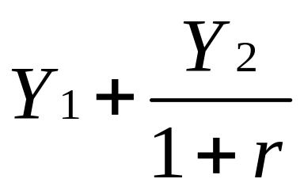
Keynes vs. Fisher
Keynes:
current consumption depends only on current income
Fisher:
Current consumption depends on the resources the consumer expects over his lifetime.
The timing of income is irrelevant
because the consumer can borrow or lend between periods.
Consumption depends on the present value of current and future incomes.
i.e.
slide <number>

Slide 34
How C responds to changes in r
C₂
An increase in r pivots the budget line around the
point (Y₁,Y₂ ).
B
A
A
Y₂
C₁
Y₁

Slide 35
How C responds to changes in r
If consumer is a saver, the rise in r makes him better off, which tends to increase consumption in both periods.
The rise in r increases the opportunity cost of current consumption, which tends to reduce C₁ and increase C₂.
Both Income and substitution effects ⇒ ↑C₂.
Whether C₁ rises or falls depends on the relative size of the income & substitution effects.
We treat consumption in both periods as normal goods.

Slide 36
Constraints on borrowing
In Fisher’s theory, the timing of income is irrelevant because the consumer can borrow and lend across periods.
Example: If consumer learns that her future income will increase, she can spread the extra consumption over both periods by borrowing in the current period.
However, if consumer faces borrowing constraints or “liquidity constraints”, then she may not be able to increase current consumption and her consumption may behave as in the Keynesian theory (Current Consumption depends on current income) even though she is rational & forward-looking.

Slide 37
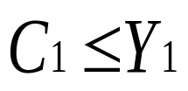
Constraints on borrowing
The borrowing constraint takes the form:
______
C₂
Budget constraint
The budget line with a borrowing constraint
Y₂
Borrowing constraint
C₁
Y₁
Notes:
Similar to Figure 16-8 on p. 445.

Slide 38
Consumer optimization when the borrowing constraint is not binding
C₂
The borrowing constraint is not binding if the consumer’s
optimal C₁<Y₁
___________.
C₁
Y₁
Notes:
(Figure 16-9, panel (a), on p.446)
In this case, the consumer optimally was not going to borrow, so his inability to borrow has no impact on his choices.

Slide 39
Consumer optimization when the borrowing constraint is binding
The optimal choice is at point D.
But since the consumer cannot borrow, the best he can do is point E.
C₂
E
D
C₁
Y₁
Notes:
(Figure 16-9, panel (b), on p.446)
In this case, the consumer would like to borrow to achieve his optimal consumption at point D. If he faces a borrowing constraint, though, then the best he can do is at point E.
If you have a few minutes of classtime available, have your students do the following experiment:
(This is especially useful if you have recently covered Chapter 15 on Government Debt)
Suppose Y1 is increased by $1000 while Y2 is reduced by $1000(1+r), so that the present value of lifetime income is unchanged. Determine the impact on C1
- when consumer does not face a binding borrowing constraint
- when consumer does face a binding borrowing constraint
Then relate the results to the discussion of Ricardian Equivalence from Chapter 15.
Note that the intertemporal redistribution of income in this exercise could be achieved by a debt-financed tax cut in period 1, followed by a tax increase in period 2 that is just sufficient to retire the debt.
In the text, pages 446-447 contain a case study on the high Japanese saving rate that relates to the material on borrowing constraints just covered.

Slide 40
The Life-Cycle Hypothesis
Franco Modigliani (1950s)
Fisher’s model says that consumption depends on lifetime income, and people try to achieve smooth consumption.
The LCH says that income varies systematically over the phases of the consumer’s “life cycle”.
Saving allows the consumer move income from times when it is low to when it is high to achieve smooth consumption.
slide <number>

Slide 41
The Life-Cycle Hypothesis
The basic model:
W = wealth
Y = Income one earns until one retires
(assumed constant) (average income)
R = number of years until retirement
T = lifetime in years (one expects to live)
Assumptions:
  zero real interest rate (for simplicity)
  consumption-smoothing is optimal

Slide 42

The Life-Cycle Hypothesis
Lifetime resources = W + (R x Y)
To achieve smooth consumption, consumer divides her resources (W + RY) equally over time (T years) and each year consumes
C = (W + RY)/T
Or
C = W/T + (RY)/T
= (1/T)W + (R/T)Y
The Y in numerator may be treated as average Y.

Slide 43
Example
If the consumer expects to live for 50 years more and works for 30 years of them, then T =50 and R = 30.
Then her consumption function is
C = 0.02W + 0.6Y
0r
C = αW + βY
where
  α = (1/T ) is the marginal propensity to
  consume out of wealth
  β = (R/T ) is the marginal propensity to consume out of income

Slide 44

Example Cont…
A person starts working when she is 30 years old, works till 65, earns an average annual income of Rs 500000 and expects to die at the age of 80.
By LCT, her consumption in any year between 30 to 80 years

Slide 45
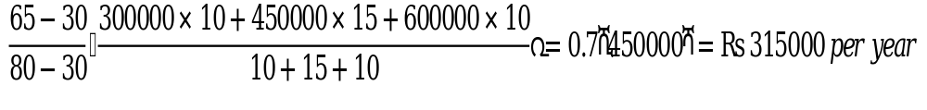
Example Cont…
If this person earns Rs 300000 annually when she is 30-40 years, Rs 450000 when she is 40 to 55 years and Rs 600000 when she is 55 to 65 years, annual consumption will be

Slide 46


Example Cont…
If the said person wins a lottery of Rs 10,00,000 when she is 60, her annual consumption will increase by
If she gets promotion at the age of 50 and her salary increases by Rs 100000 per annum, her annual consumption will rise by

Slide 47

Example Cont..
If her annual net wealth is Rs 100000, her consumption will increase by

Slide 48
Implications
For any given level of wealth, the model yields a conventional consumption function.
However, the intercept is not a fixed value.
Intercept is αW and thus depends on wealth.

Slide 49



The Life Cycle Consumption Function
C
Y

Slide 50
Implications
The LCH can solve the consumption puzzle:
  The APC implied by the life-cycle consumption function is
  C/Y = α(W/Y)+ β
  In the short-run, across households, wealth does not vary as much as income, so high income households experience low APC.
  In the long-run, aggregate wealth and income grow together, resulting in constant W/Y and constant APC.

Slide 51
Implications put differently
For a given wealth, LC consumption function behaves similar to what is Keynes’.
This holds only in the short run, as wealth is constant.
In the long run, C function shifts upward that prevents APC to fall as Y increases.

Slide 52
Implications of the Life-Cycle Hypothesis
$
The LCH implies that saving varies systematically over a person’s lifetime.
Wealth
Income
Saving
Consumption
Dissaving
Retirement
begins
End
of life

Slide 53
Limitations
Future incomes are unknown and thus the life time average income may be uncertain.
Capital market may not be quite conducive for borrowing or savings.

Slide 54
The Permanent Income Hypothesis (Milton Friedman,1957)
While LCH suggests that income follows a regular pattern over a person’s life time, the PIH emphasizes that people experience random and temporary changes in their incomes from year to year.

Slide 55
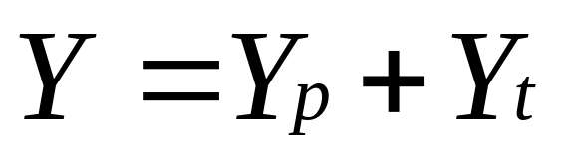
The Hypothesis
The PIH views current income Y as the sum of two components:
  Permanent Income: Y ^{P} (average income, which people expect to persist into the future): Average Income
  Transitory Income: Y ^{T} (temporary deviations from average income): Random Deviation from Average Income

Slide 56
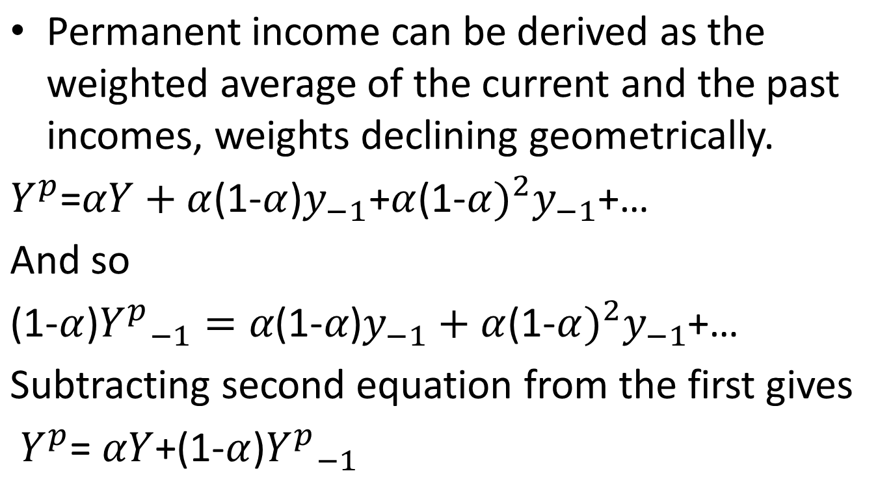

Slide 57
A good education provides permanently higher income
A good monsoon provides transitorily higher income.

Slide 58

Consumption is a function of permanent income.
where α is the fraction of permanent income that people consume per year.
C is proportional to Yp.
Consumers use saving & borrowing to smooth consumption in response to transitory changes in income.
Consumers spend their permanent income (salary rise annually) and save their transitory income (lottery).

Slide 59
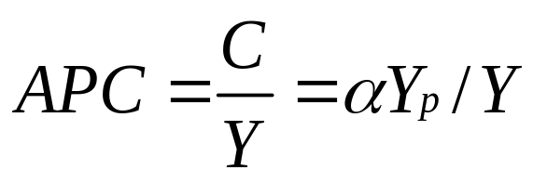
Implications
The PIH can solve the consumption puzzle: C depends on Yp and not on current income.
APC depends on the ratio of permanent income to current income.
When current income rises temporarily above Yp, APC temporarily falls and vice versa.
  To the extent that high income households have higher transitory income than low income households, the APC will be low.
  Saving ratios are high during boom and low during recession.
  When transitory income is positive, Y > Yp and Yp/Y < 1.
  Over the long run, income variation is due mainly if not solely to variation in permanent income, which implies a constant APC.

Slide 60
PIH vs. LCH
In both, people try to achieve smooth consumption in the face of changing current income.
In the LCH, current income changes systematically as people move through their life cycle.
In the PIH, current income is subject to random, transitory fluctuations.
Both hypotheses can explain the consumption puzzle.
slide <number>

Slide 61
Relative Income Hypothesis
(Duesenberry)
Defining Relative Income
Current income relative to the past peak income
Own income relative to the average income in the neighborhood/nation

Slide 62
How it works?
Consumption determines the standard of living and by habit, people enjoy raising their standard but hate letting it slide downwards.
When income rises, they raise their consumption but they refuse to reduce their consumption when income falls.
Ratio of the household's current income to the past peak income acts as an additional determinant of its current consumption.
If this ratio falls, ceteris paribus, the current consumption goes up and vice versa.

Slide 63
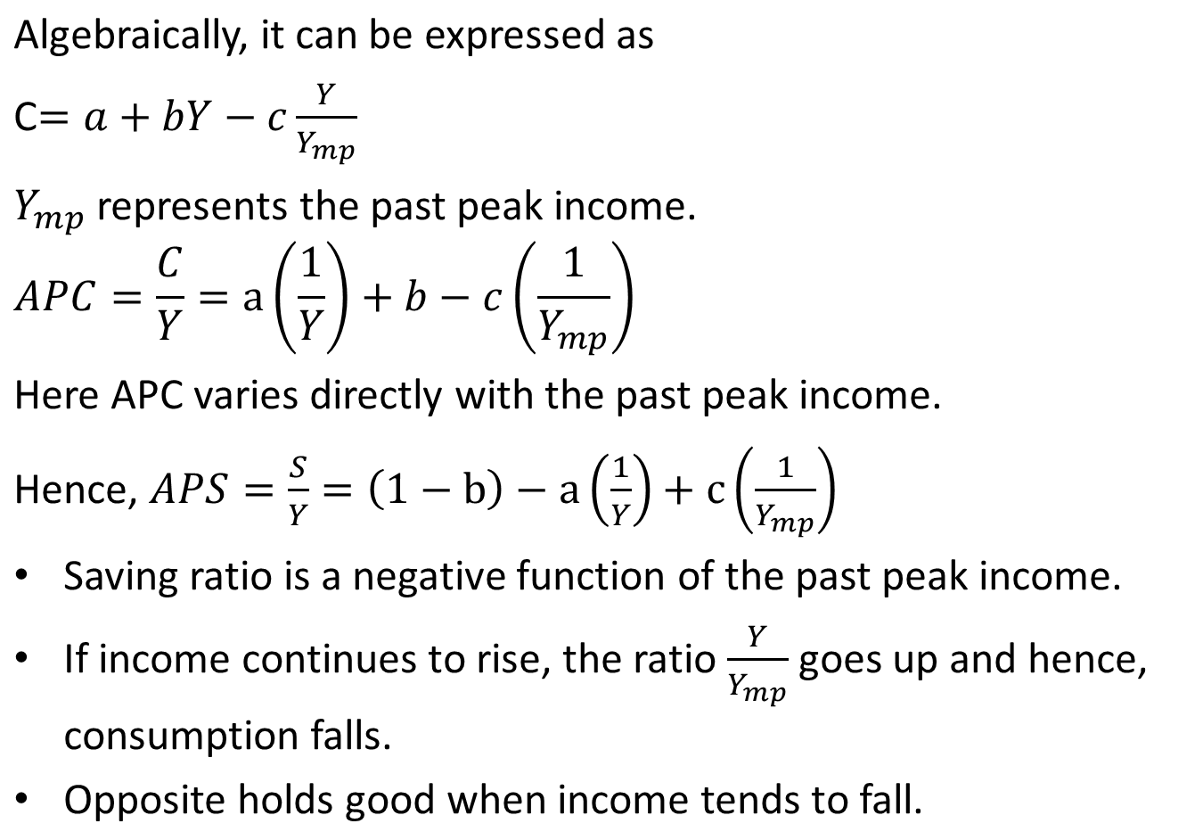

Slide 64
Implications of RIH
An economy’s saving ratio rises slower than otherwise during the time of prosperity and to fall slower than otherwise during recession.
Hence, prosperity may not lead to recession.

Slide 65
Rational Expectations
(Robert Hall,1978)
based on Fisher’s model & PIH, in which forward-looking consumers base consumption on expected future income
Under adaptive expectations, economic agents only consider the past values of the variable about which they form the expectations.
A rational agent uses all information. Failure to use all available information would result in systematic or predictable errors between actual and predicted outcomes.
Hall adds the assumption of rational expectations: People use all available information to forecast future variables like income and the expectations are said to be rational.
If agents use all available information, the error between the expectations and the outcomes will be unsystematic, no detectable pattern and hence will be a random or independent term.
slide <number>

Slide 66
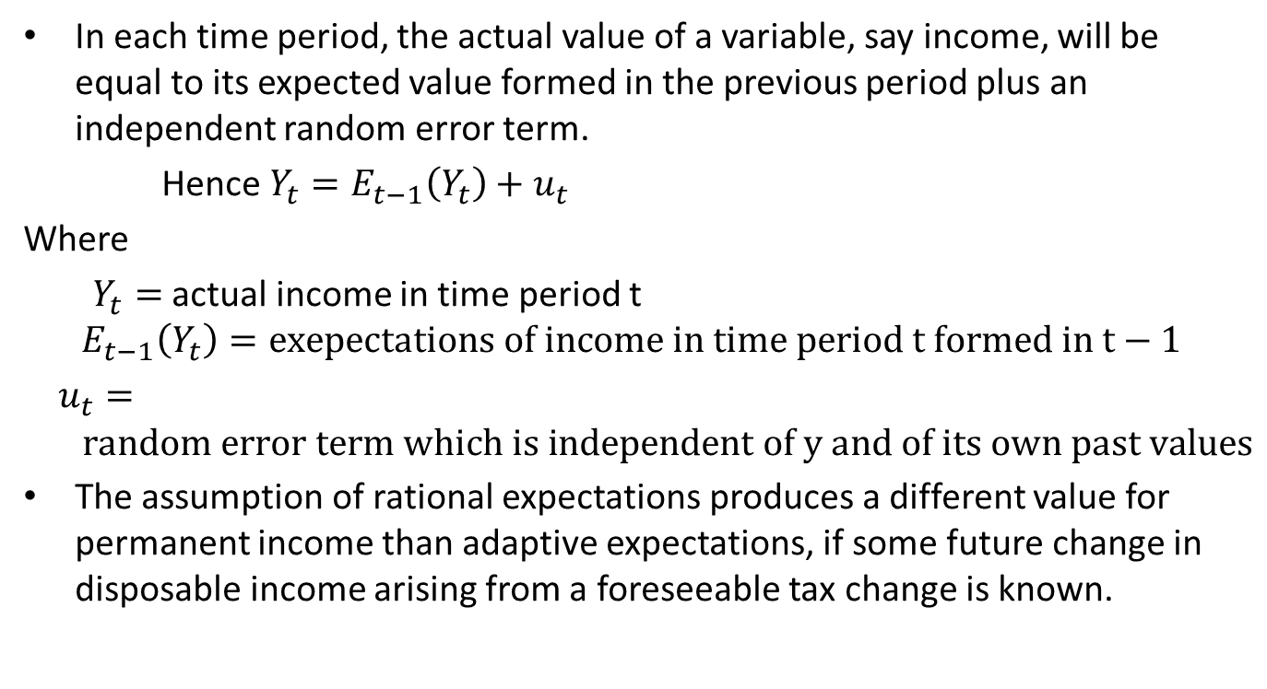
Rational Expectations Cont…

Slide 67
The Hypothesis
If PIH is correct and consumers have rational expectations, then changes in consumption over time is unpredictable
Consequently, consumption should follow a random walk.
  A change in income or wealth that was anticipated has already been factored into expected permanent income, so it will not change consumption.
  Only unanticipated changes in income or wealth that alter expected permanent income will change consumption.

Slide 68
Implications
If consumers obey the PIH and have rational expectations, then only unexpected policy changes will affect their consumption

Slide 69
The Psychology of Instant Gratification
(David Laibson)
Theories from Fisher to Hall assumes that consumers are rational and act to maximize lifetime utility.
Recent studies by David Laibson and others consider the psychology of consumers.
slide <number>

Slide 70
The Psychology of Instant Gratification
Consumers consider themselves to be imperfect decision-makers.
  E.g., in one survey, 76% said they were not saving enough for retirement.
Laibson: The “pull of instant gratification” explains why people don’t save as much as a perfectly rational lifetime utility maximizer would save.
slide <number>

Slide 71
Two Questions and Time Inconsistency
  1. Would you prefer
  (A) a candy today, or
  (B) two candies tomorrow?
  2. Would you prefer
  (A) a candy in 100 days, or
  (B) two candies in 101 days?
In studies, most people answered A to question 1, and B to question 2.
A person confronted with question 2 may choose B.
When he is confronted with question 1, the pull of instant gratification may induce him to change his mind.
slide <number>
Notes:
The text discusses time inconsistency in this context. Time inconsistency was introduced and defined in chapter 14.

Slide 72

Summing up
Keynesian consumption function:
where only current income (Y) mattered.
Other models advocate that other things should be included:
  expected future income (permanent income model)
  wealth (life cycle model)
  interest rates (Fisher model)
  but current income should still be present (due to borrowing constraints)
  Consumer Expectations
  Income/wealth distribution
  Credit availability
slide <number>

